Slide 1
Case Study Research for Chaplains
Transforming Chaplaincy
Spiritual Care week Webinar
Notes:
Goals of the webinar: 1. Highlight important work done to date – cases and research materials available. 2. no shortage of cases, but shortage of confidence to do the writing and take to next level for publishing. Make a case for more cases especially in gap areas or identified themes. Demystify 2. Engage and provide skills to Groups of researchers to analyze existing cases, comparative.

Slide 2
Presenters
M. Jeanne Wirpsa, MA BCC HEC-C
Research Chaplain, Department of Spiritual Care and Education
Program Manager & Clinical Ethicist, Northwestern Memorial Hospital
Faculty, MacLean Center for Clinical Ethics, University of Chicago
Convener, Chaplaincy Functions Research Network, Transforming Chaplaincy
Cate Michelle Desjardins, MDiv, MPH, BCC
Convener, Pediatric Spiritual Care Research Network, Transforming Chaplaincy
Executive Director, Mennonite Healthcare Fellowship / Mennonite Chaplains Association
Transforming Chaplaincy Fellow

Slide 3
Outline and Logistics
Chaplaincy Case Studies: Why do we need them?
Current Status: Published, in process, and opportunities
Case Study Research: A Qualitative Methodology
The Nuts & Bolts of Writing a Case Study
The Ethics of Writing Case Studies
Analyzing Case Studies
Lifting the Veil: Comparative Analysis
Generating Hypothesis for Future Research
Beyond the individual story of care – large scale cases
Please submit questions through the ”Questions” box
Notes:
It’s going to be a little messy. Who wants to be doing this research? How can we connect to each other? We want to facilitate connections between people we are the beginning stages

Slide 4
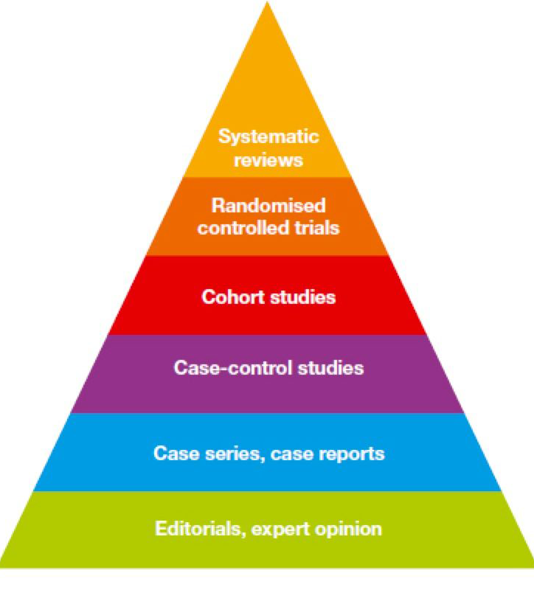
Making a Case for Chaplaincy Case Study Research
Case Studies are the literal “Bread and Pasta” of our Pyramid of Evidence
Vital for building the field of chaplaincy and chaplaincy research
Education of chaplains and of non-chaplain healthcare colleagues
Skills for writing case studies are inherent to many chaplains because of our training process
Need a large # of case studies to understand themes and patterns.
Excellent entry-point for research-hesitant chaplains
Case studies and reports are an accepted form of evidence in the medical field. This puts us on “playing ground” with our colleagues.
Notes:
Burns, P. B., Rohrich, R. J., & Chung, K. C. (2011). The levels of evidence and their role in evidence-based medicine. Plastic and reconstructive surgery, 128(1), 305–310. https://doi.org/10.1097/PRS.0b013e318219c171

Slide 5
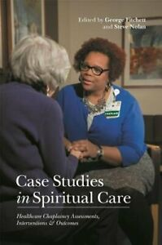
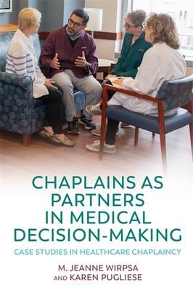
Chaplaincy Case Study - BOOKS
Fitchett & Nolan, 2015
Fitchett & Nolan, 2018
Wirpsa & Pugliese, 2020
Kruizinga, et al, 2020
Notes:
JHCC series and unpublished cases Dutch project, University of Muenster Military Chaplains 40+, etc.

Slide 6
Chaplaincy Case Studies: Current Status
Chaplain care in Pediatrics
Psychiatric Case Studies
Care for Veterans
Chaplains leading Ritual(s)
Palliative Care
Medical Decision-Making
Narrative Theory
Chaplain care for Transgender Individuals
Primarily Hospital/Inpatient-Based Care

Slide 7
Case Studies as a Research Methodology
Notes:
In and of themselves = research AND a body of evidence (data) generating insights, info, theory and hypotheses for qualitative or quantitative studies. What George Fitchett and Steve Nolan have termed practice-based evidence Practice-based evidence of what chaplains do rather than high level generalizations: context-dependent knowledge

Slide 8
Types of Case Studies – Single
Intrinsic
descriptive
Represent nothing but themselves
Single case with depth and complete understanding
Researcher wants to gain insight into one unique situation – not generalizable.
Describes a case
Explorative
Provides an understanding of the case against the background of its context, uses fieldwork and data collection. Often considered a prelude to social research.
Instrumental
Represents a more common/general phenomenon
Single case, but exploring various factors of this case to relate them to theory or to a question – more a breadth issue
Focuses on an issue or concern and uses one bounded case to illustrate this issue.
Explanatory-causal
Interprets phenomena to the point of answering questions of “why” on a theoretical basis.

Slide 9
Considerations in Case Studies
Clinical Settings [i.e. Pediatrics, Emergency, Psychiatric Inpatient, VA, General Med/Surg, Outpatient]
Intervention type [i.e. Chaplains as Partners in Medical Decision-Making]
Chaplain characteristics [Religion, Race, Training, etc.]
Extraordinary care or ordinary/best-practices
Patient characteristics [Religious/Nonreligious, Gender, etc.]
Medical Features [i.e. early Alzheimer’s diagnosis, pregnancy complication, bullet wound, etc.]
Notes:
Combine with previous

Slide 10
Getting Started: Selecting a Case(s)
Read other published case studies in chaplaincy
Must move away from “Verbatim” thinking:
Case does not have to be extraordinary
Does not have to showcase chaplain in best light
Should be about profession of chaplaincy
What chaplains do
How patient needs/situations shape our care
Assessments, Interventions, Outcome
What was the most “typical” case you have worked recently? What made it so? Can you capture what you did and why?
Seeking a case: Start from scratch, decide that one of the cases you begin today will be a case study. Take careful notes. Seek permission from the patient/family when the time is right. Whatever happens this is evidence for your case study.

Slide 11
Case Study Writing: Nuts & Bolts
General Template for Case Study - Fitchett and Nolan, 2015; Fitchett, 2011
Context for the case - Information about patient and/or family, illness/reason for choosing case; biographical outline of chaplain providing care (location, bias, institution, experience level).
Case Study Narrative:
Describe the history of the chaplain-patient/chaplain-family relationship
Focus on significant moments and interventions in chaplaincy care
Include verbatim accounts of important conversations, if available/applicable
Critical Reflection on Case/Care Provided
Assessment>Interventions>Outcomes
Conceptual Frameworks (eg. Narrative medicine, theory of grief, family systems literature).
If case study on particular area of chaplaincy care, interprofessional team dynamics, or theme/topic (e.g medical decision making, care to the non-religious, cross-cultural care, use of rituals) critically reflect on practice and outcomes using analytical frameworks.

Slide 12
Ethics of Case Study Research
Protecting Patient & Family Privacy
We are seeking a balance between preserving the richness of the chaplain encounter with a patient and/or family and protecting their privacy. Accepted practice in the publication of case studies is to disguise patient and families to protect them from being identified by someone who reads the cases.
Identifiers such as social security numbers, URLs, medical record numbers are not likely to appear in chaplain case studies. Other “unique identifying characteristics” to omit, limit or alter unless essential to the phenomena being described include:
names
specific age
institution where care provided
name of religious congregation or clergy
details about patient’s health condition and course of treatment.
Other common strategies to protect privacy:
obscure case detail by adding extraneous material
build composites of two or more cases.
You may consider submitting your case studies to supervisors or colleagues for review who area aware of the case for adequacy of disguise and professional integrity.
Patient/Family Permission to Publish Full Case Study
While consent of patient and family is not required to publish case studies, emerging consensus for the profession of chaplaincy is for the author to seek patient/family permission to publish their story whenever possible.
Based upon your relationship with patient and/or family, you may also choose to invite them to assist in identifying which features will be disguised and/or provide them with a draft of the case to review before it is submitted for final editing and publication.
David B. McCurdy & George Fitchett (2011): Ethical Issues in Case Study Publication: “Making our Case(s)” Ethically, Journal of Health Care Chaplaincy, 17:1-2, 55-74.
David B. McCurdy, “Ethical Issues in Case Study Publication,” in Fitchett and Nolan, Spiritual Care in Practice: Case Studies in Healthcare Chaplaincy, pp. 282-298.

Slide 13
Case Studies as a Body of Evidence (DATA)
Notes:
A single case narrative describes and explains a phenomenon sufficiently and adequately according to its uniqueness and completeness – Social Sciences, Yin, Stiles, etc: use multiple case studies to generate, modify and critique assumptive frameworks – theory-building.

Slide 14
Instrumental Case Studies

Slide 15
Patient as Person | Emotions and Family | Religious & Cultural Differences
Keith, 59 year old living with stage IV bladder cancer; outpatient infusion center – 10 visits; Mutually expressive writing; Narrative Medicine. | Rita, family matriarch with advanced dementia. ”She fed all of us, how can we not feed her”. Religious values embedded in multi-general family system. Family Systems Theory. | Orthodox Jewish parents advocating for daughter with brain injury. Rabbi chaplain bridged to understanding unique approach to decision making of community. Cultural Theory.
Glen’s “Mission” a 72 year old man, living until his sense of purpose was fulfilled. Patient not being heard re timing of moving to comfort care, religiously informed goal. Dignity Therapy, Narrative Medicine. | Mark, a middle aged man in acute respiratory distress preferences not solicited by medical team. Daughter – patient conflict re: removing trach. Guilt, grief and communication by chaplain. Surrogate Decision Making, Miracle Literature. | Alma, African American elderly woman “dying from a broken heart”. Broker between medical explanation of illness vs. family causal explanation impeding movement toward decision. Fadiman, Multi-cultural Theorists.
Bob, a middle aged husband and father facing treatment decisions for 2nd life-threatening illness. Chaplain had 7 year relationship with patient/family – doctors asked for her help. Shared Decision Making, Narrative Medicine. | Aaron, 45 year old man with life-threatening cardiac event whose wife and daughter conflicted about “giving up on him”. Use of ritual to address emotions and family roles. Post-Traumatic Growth and Ritual theory. | Ayesah, a 50 year old Palestinian Muslim woman dying in the ICU. Refusal by family of pain medication and brain death determination negotiated by chaplain. Trauma, Cultural Diversity Theory, Family Therapy.

Slide 16
Analysis of Case Studies: Research Method
Interpretative Lens: Cases represent when chaplains assess they have been effective in promoting decision making; barriers to inclusion removed.
Theoretical Propositions:
Integration into IDT facilitates chaplain role in MDM - How IDT structured, chaplain role on team? (descriptive analysis)
Chaplain involvement promotes value-concordant, patient-centered MDM: True or no? If so, what does that look like? (descriptive & causal analysis; rival explanations)
Notes:
Yin, “Too many times, the investigators start case studies without having the foggiest notion of how the evidence is to be analyzed.” Did our original research design include “a design for analyzing the case studies” – not really beyond the request we made of the authors to name their theoretical framework and use it to analyze their role in the specific area of support for mdm.
Not use grounded theory to analyze all case studies because already had theoretical propositions – so far have eturned to our case studies with these 2 propositions/lenses.
See Robert Yin: Analytic Strategy – Relying on theoretical propositions
Focus attention on certain data and ignore other (mention other themes, insights that emerged in our original “close read and re-read” plus authors of each section focused on that theme as did the respondents.
Pattern matching: to lift up domains, patterns, notice outliers once extracted relevant sections of text
Combining exploratory and this is in conversation with original paper and other data points.

Slide 17
Chaplain Role on Medical Team
Referral Source, Visit Type, Mode of Communication
Empowers patient voice, decision making without interacting with team but this is the exception (outlier case)
Care conferences/family meetings
Present when doctors visit
Clinicians ask directly for help, insights on how to communicate with family
One-on-one meetings with team members before or after visits
Read the medical record
Pre-conditions that enable chaplain to be integrated and effective
Length of service & trust established
Knowledge & appreciation of other roles
Insight into what medical team experiencing/reasons behind recommendations
Attention to staff moral distress
Legitimacy from spending extended time getting to know patient and family
Notes:
Pre-conditions: Kirby, 5 years, trusted; called countless times to resolve conflict
Wirpsa: long term relationships with oncologist; two physicians reached out to her.
Axelrud observes team dynamics, avoiding family, meets individual and informally to educate
Care for the team; addressing distress
Rosencrans: Ethics and palliative care member
Swofford: attends to individuals on team rather than care conference
Axelrud: only sees the family by themselves
Rosencrans, IDT, family conference
Goheen: care conference, idt – chaplain facilitating with other members of team there
Galchut: outpatient setting means he sees patient 10 times not once with other providers yet impacts patient decision by empowering pt.
Hogg: on his own 10 visits empowers patient
Swofford, psychiatric consult, uses doctor partners, pt relations, risk
Kirby: physicians and team but not mention nurses or sw or pscyh
Hogg: Palliative care
Wirpsa: nurses on unit; physicians/oncologist outpatient
(educative role of Rosencrans, Kirby interrupting dr. lee in conference to explain); Goheen takes lead asking doctor questions and family so they will speak empowering; Wirpsa asking the radical question to doctor at
“I decide to intervent in the conversation to reframe it since I was the only on from the Palliative Care team who had been present during our previous conversations about what is important to you. (Hogg)
LINES UP WITH WHAT LITERATURE TELLS US ABOUT CONDITIONS FOR INTERPROFESSIONAL COLLABORATION: SHARED VISION OF DM STYLE, UNDERSTANDING AND APPRECIATION OF OTHER’S ROLE, TOOLS TO COMMUNICATION, OVERLAPPING SCHEDULES AND CONTINUITY OF RELATIONSHIPS, POWER SYMMETRY

Slide 18
Chaplain Role on Medical Team
Authority, Leadership, Initiative
Speak up, ask questions at strategic points with team
Educator about traditions or reasons why resistant,
Lead family meeting
Claim pastoral authority
Advocate through use of resources
Awareness and naming of role
What’s absent (re: barriers)
No mention of being paged away or interrupted
One case: ”goes around” team when no movement to pt-family
Able to be in outpatient and inpatient settings if needed
Little concern for trespassing
No mention of chaplain documentation in the EMR as a way to communicate!
Notes:
scripture, knowledge of religion, knowledge of family or patient
to find a way for Mark’s medical preference to be respected: Psych consult; review ADV Dir.
translator, negotiator, bridge, “collaborative and consensus leadership”

Slide 19
Value-Concordant Care
Specific goals, who person is, what really matters
Identifying approach to mdm more general , timing
Movement to decision making restored
Value concordance not static: Hold in tension competing values – “until they can find a version they can live with”
Person of chaplain/therapeutic presence underlies ability to see patient as person, attend to emotions/family and appreciate cultures thereby promoting value-concordant care.
Notes:
In these three cases, each chaplain assists in aligning the medical plan with patient values through their creative and sensitive attention to the patient’s story. However, the process is neither static nor unidimensional. None of these patients entered into the decision making process with a clearly delineated healthcare preference documented, as some might wish, in an advance directive. Chaplain Hogg’s patient Glen was arguably the clearest about his goal -- to complete his “mission” -- and the chaplain ensured the timing of moving toward comfort care coincided with this goal. As described by Chaplain Galchutt, Keith engaged in a process of “discerning” what mattered to him in the context of his life-threatening illness. As his illness advanced and began to take a toll on his quality of life, he was able to draw upon the insights gained through writing about his experience to better articulate what really mattered to him. In Chaplain Wirpsa’s case, Bob and his family wrestled with competing values – his independence and dignity vs. value of family and identity as their protector. It was over time and with painful attention to Bob’s multiple story lines that the chaplain ensured that specific medical decisions were patient-centered.
suffering, pain , futility, mission, advocating for voice over against daughter, etc)
Timing: clinical momentum, step by step slow motion unfolding can be seen – building trust, planting seeds, reframing, therapeutic presence. Key moments where the chaplain slowed things down, intervened to step back and identify who the patient/family were…Jackie Kruser and colleagues.
Definition: value concordant care involves shifting understanding/expanding framework not denying it - evolution, development with attention to underlying factors with chaplain interventions (distrust, irreconcilable perspectives).
salient example for each. Yes decision outcomes respect patient preferences but also redefine what “value-concordance” looks like.
Therapeutic presence, building trust, connecting deeply key to all of this – see NOLAN at 2018 APC/NACC conference. Presence, active listening not VS. Outcome oriented approach. A false dichotomy

Slide 20
Causal Analysis Internal Validity Testing with Rival Explanations
Direct rival: An intervention other than the target intervention accounts for the results
Commingled rival: Other intervention and the target intervention both contributed to the results
Rival theory: Another theory different from the original theory explains the results better
Super rival: A force larger than but including the intervention accounts for the results
Notes:
Commingled Rival: Patient or family’s own pastor, outside counseling, support of the nurses? Patient and family own processing without the chaplain…even as supported by the chaplain. Could the shift, movement have occurred if chaplain not involved? DK
Super rival - sicker they get, the more willing to accept reality – inverse relationship between goals of care (aggressive-palliative) and where they are on the course of illness/degree of physical suffering and side effects from treatment.

Slide 21
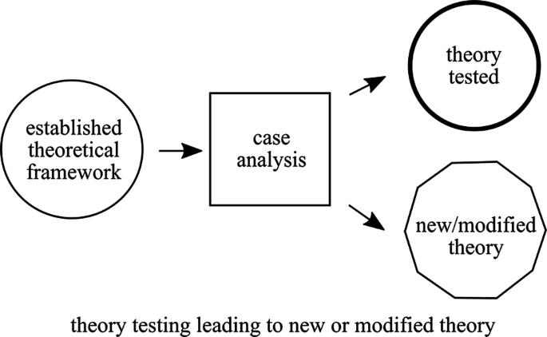
Theory-building: Cross-Case Analysis
“What do chaplains do, for what reasons, and to what ends” (Walton and Korver, 2017, p.271)
Steve Nolan, “Building Toward a Theory of Chaplaincy Care” in R. Krusizinga (2020)
Analysis of multiple case studies both confirms and confounds reigning presupposition that chaplaincy care is: “delivered by religious professionals and therefore is religious intervention.”
Chaplain-patient therapeutic alliance – interventions in and through the relationship.
Chaplaincy care has the form of psychospiritual therapy. It is both like psychotherapy and has unique characteristics.
Notes:
Depending on goal: descriptive – thematic methodology; for cross case development – grounded theory with constant comparison.

Slide 22
Methodology Multiple Case Study Research
Case Selection/Sampling
APPROACHES/TECHNIQUES
1. Interpretative: ethnographic ethos sought – don’t know in advance what might yield; grounded theory. (Lifting the Veil)
2. Pattern Matching: Do they match across patient cases? Are there cases that contradict? Lens focuses on only some data to exclusion of other.
3. Explanation/Theory Building: test the explanation or assumption, refine, retest (iterative process).
4. PROCESS Analysis: Trace changes over time. What leads to what and why. Horizontal analysis – compare way similar phenomena unfold in distinct, socially produced locations. AIM: increase understanding of processes that shaped each case.
Number to compare: Why 3 instead of 10?
Status of case: representative, paradigmatic, outlier, critical case?
Purposive sampling: select cases relevant to the conceptual framework or research question.
Do I have cases that challenge or call into question the patterns emerging? Variation vs. homogeneity
Communal project: What is missing based upon expert knowledge (do we need more cases? Do they exist already?)
Reflexivity and representation: WHO decides what is included and excluded – Include perspective of actors; attention to power and inequality
Notes:
Collaborate with experts – Qualitative analysis, people who teach courses iin your social science department in Universities, your anthropologists. People who have methodological rigour and may be willing to contribute their expertise. Who know s how to do focus groups?

Slide 23
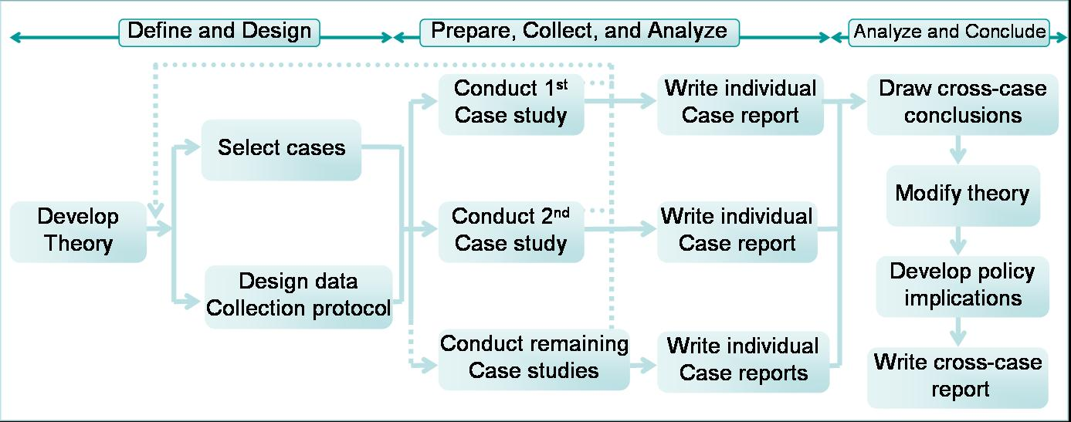
Multiple Case Study Research Intentional Design: Methodology
Aim or goal> audience> sampling and analysis decisions
Comparing Multiple Case Studies of (Military) Chaplaincy
T Pleizier & C Schuhmann, in R. Kruizinga, Learning From Case Studies in Chaplaincy (2020)
Notes:
SEE Military Case study – process of inclusion and exclusion, comparison, community approach. ADVANCED. Social Science research on higher level cases – combine participant observation and case studies. Ethnography as a case study method – Wendy Cage’s book.
What status does a case occupy

Slide 24
Research Opportunities: Multiple Cases Published Case Studies & New Collections
Theodicy/Spiritual distress
Kinds – do theodicies present in cases confirm or confound existing models? What alleviates?
Piderman
Swift
Redl
Cooper
Concordance/Discordance between chaplain location/beliefs and patient/family
Compare and contrast when concordant
Compare cases of concordance with discordance
Ratcliff – Nigerian man, witch (discordant)
Rosencrans – Allah will decide (discordant)
Goheen – She has fed us all . . (concordant)
Care for NON-religious by chaplains (see Nolan 2020)
Use of Ritual
Pediatric vs. Adult
Assessment models used by different chaplains
Military chaplaincy vis a vis healthcare chaplaincy
NEW COLLECTIONS/OPPORTUNITIES
Maternal/fetal medicine, baby loss
Telemedicine
Care of Staff
Rehabilitation Care/Outpatient care
Specific kinds of interventions or areas of focus (eg. Family meetings, Addressing Anxiety through meditation, counseling, distraction therapy, etc)
Notes:
First ask: What status does a single case occupy: representative?

Slide 25
Audience Questions and Discussion

Slide 26
Next Steps
Sign up for the Chaplaincy Functions Network: https://www.transformchaplaincy.org/about/research-incubator/
Use Mighty Networks (MN) platform for communication, discussion, sharing of ideas and advancing research: https://transforming-chaplaincy.mn.co/
This presentation and PPT will be available on MN and Transforming Chaplaincy YouTube
Contact presenters: M. Jeanne Wirpsa jwirpsa@nm.org & Cate Michelle Desjardins catemdesjardins@gmail.com

Slide 27
Resources & References
Bartlett, L and Vavrus, F. (2017). Rethinking Case Study Research: A Comparative Approach. Routledge Press.
Burns, P. B., Rohrich, R. J., & Chung, K. C. (2011). The levels of evidence and their role in evidence-based medicine. Plastic and reconstructive surgery, 128(1), 305–310. https://doi.org/10.1097/PRS.0b013e318219c171
Crowe, S., Cresswell, K., Robertson, A., Huby, G., Avery, A., & Sheikh, A. (2011). The case study approach. BMC medical research methodology, 11, 100. https://doi.org/10.1186/1471-2288-11-100
Fitchett, G. (2011) Making Our Case(s), Journal of Health Care Chaplaincy, 17:1-2, 3-18, DOI: 10.1080/08854726.2011.559829
Fitchett, G. & Nolan, S. (Eds.). (2015). Spiritual Care in Practice: Case Studies in Healthcare Chaplaincy. Jessica Kingsley Publishers.
Fitchett, G. & Nolan, S. (Eds.). (2018). Case Studies in Spiritual Care: Healthcare Chaplaincy Assessments, Interventions, & Outcomes. Jessica Kingsley Publishers.
Kruizinga, R., Körver, J., Walton, M. & Stoutjesdijk, M. (Eds.). (2021). Learning from Case Studies in Chaplainy: Towards Practice Based Evidence and Professionalism. Eburon Academic Publishers.
McCurdy, D.B. & Fitchett, G. (2011): Ethical Issues in Case Study Publication: “Making our Case(s)” Ethically, Journal of Health Care Chaplaincy, 17:1-2, 55-74.
Riessman, C. K. (2008). Narrative Methods for the Human Sciences. Sage Publications.
Stake, R.E. (2006) Multiple Case Study Analysis. Guilford Press.
Thomas, G. (2016) How to Do Your Case Study. Sage Publications.
Wirpsa, M.J. & Pugliese, K. (Eds.). (2020). Chaplains as Partners in Medical Decision-Making: Case Studies in Healthcare Chaplaincy. Jessica Kingsley Publishers.
Wirpsa, M.J , Johnson, E.R., Bieler, J., Boyken, L., Pugliese, K., Rosencrans, E., & Murphy, P. (2019). Interprofessional Models for Shared Decision Making: The Role of the Health Care Chaplain. Journal of health care chaplaincy, 25(1), 20–44. https://doi.org/10.1080/08854726.2018.1501131
Yin, R.K. (2009). Case Study Research: Design and Methods (4th ed). Sage Publications.

