Slide 1
Empowerment Model for Spiritual Care Integration in Behavioral Health
Rev. Rachel Daley, BCC

Slide 2
Organizational Challenge

Slide 3
Spiritual Care in Response to Behavioral Health Concerns
Organizational Challenge
Prevalence: 1 in 5 U.S. adults experience mental illness each year
Comorbidity between mental and medical conditions is the norm
Barriers limit access to behavioral health care
Health disparities particularly impact vulnerable populations
This Photo by Unknown Author is licensed under CC BY-ND
Religion and spirituality are generally supportive but can also negatively impact mental health
Interactions between r/s and mental health require nuance and sensitivity

Slide 4
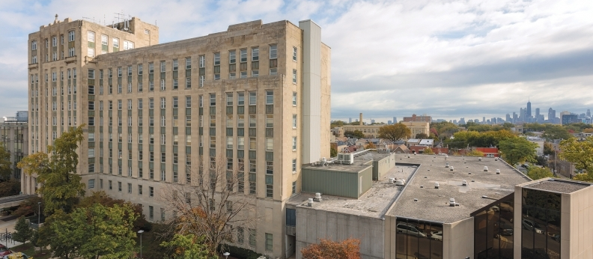
Behavioral Health Needs in Community Hospital
Organizational Challenge
Shift in inpatient volumes toward Behavioral Health
Approximately half of inpatient volume hospitalized in Behavioral Health units
Significant comorbidity of BH concerns and social barriers in all patient care settings

Slide 5
Behavioral Health Needs and Challenges to Chaplain Practice
Organizational Challenge
Inadequate resources to support spiritual needs of patients and associates in inpatient Behavioral Health
Inconsistent chaplain competence and experience in Behavioral Health

Slide 6
Applied Learning Project

Slide 7
Spiritual Care Integration in Behavioral Health
Applied Learning Project
Significant unmet spiritual need among patients and associates
Address disparity between needs and resources
Align with values as Catholic healthcare, provide holistic support and attend to needs of the poor and vulnerable

Slide 8
Spiritual Care Integration in Behavioral Health
Applied Learning Project
Desired Outcomes
Shift in resource allocation
Unit-integrated chaplain to provide consistent presence and associate support
Chaplain education for increased competence
Improved chaplain practice and care

Slide 9
Progress

Slide 10
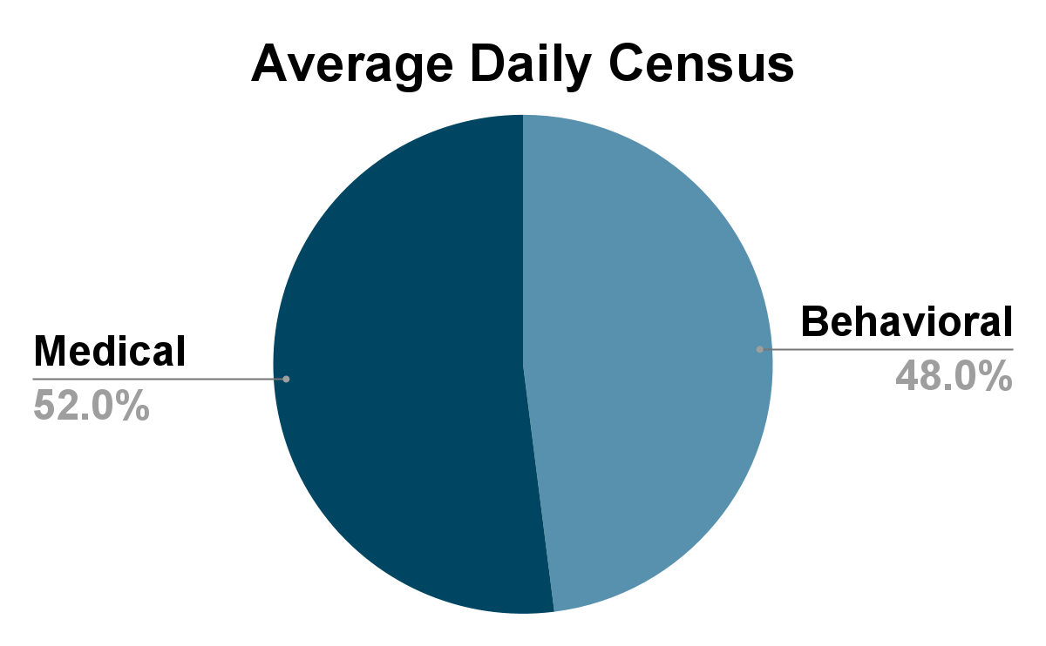
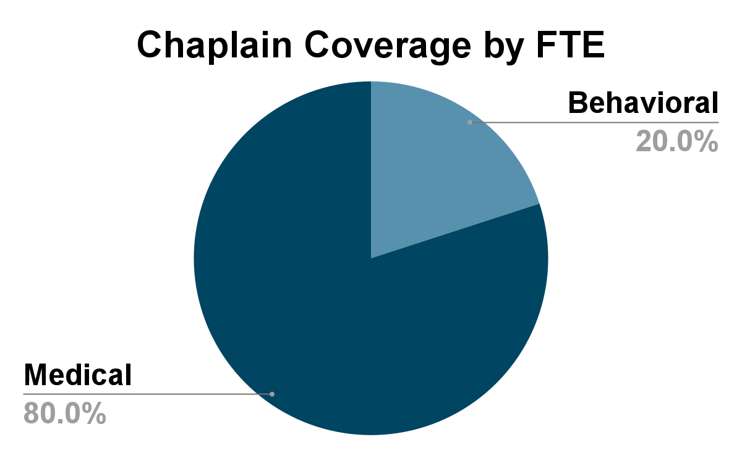
Evaluating Resource Allocation
Applied Learning Project
Unit Assessment Process
Collect data about volume and acuity
Unit assessment form to solicit chaplain input about coverage needs
Presented data in a series of individual and team conversations
Shift in FTE resources toward BH
Tradeoff in terms of palliative care collaboration

Slide 11
The Behavioral Health Empowerment Model
BH
Leader
Curriculum development
Innovation and advocacy
Chaplain education and research
BH Chaplain Practitioner
Integrate with BH IDT and provide associate care
Facilitate groups
Respond to complex BH needs
BH Informed Chaplain
Provide compassionate care for BH needs of patients and associates in all settings

Slide 12
Leader
Behavioral Health Informed Chaplain
Who
All chaplains and CPE students
Knowledge Base
Conceptualize and communicate about mental illnesses and symptoms using medical model
Understanding of basic behavioral health concepts: depression, trauma, suicidality
How to promote safety of patient and chaplain and provide appropriate resources
Progress
Focused Behavioral Health Orientation
Interview and Hiring Process
Practitioner
Informed Chaplain

Slide 13
Leader
Behavioral Health Practitioner
Who
Chaplains who consistently work in BH unit
Knowledge Base
Understanding of mental illness and appropriate individual/group spiritual care interventions for acute behavioral health needs
Progress
Identify chaplains with skill and interest and develop competence through education, shadowing, mentorship and peer support
Shift to team-based clinical approach
Quality improvements to group materials
CPI training for Chaplain Practitioners
Practitioner
Informed Chaplain

Slide 14
Leader
Behavioral Health Leader
Who
Experienced chaplains working in Behavioral Health and with leadership capabilities
Knowledge Base
Best practices in providing Spiritual Care in Behavioral Health settings
Mentor and coach chaplain peers in developing BH competence
Progress
Develop relationships with Behavioral Health leaders
Education for Nursing Students
Curriculum Development
Practitioner
Informed Chaplain

Slide 15
Key Learnings

Slide 16
Empowerment as a Model for Chaplain Specialization
Key Learnings
Leader
Model reflects a framework for thinking about chaplain skill and competence
Chaplains need basic competence in critical areas and working with diverse populations
Framework to understand skills and competence and to recognize expertise and leadership
Chaplain Leaders support the clinical practice of all chaplains
Chaplain Practitioner
Informed Chaplain

Slide 17
Need for Ongoing Cultural Change
Key Learnings
Spiritual Care | Normalize Behavioral Health as an area of chaplaincy care
Behavioral Health | Integrate Spiritual Care in Behavioral Health settings
Institution | Address institutional stigma to support dignity of all

Slide 18
Ascension Housing and Health Alliance
Key Learnings
Stable housing and support services for individuals impacted by substance use, housing insecurity and chronic illness:
Bonaventure House
The Harbor
Bettendorf Place
Community Housing
For questions, conversation or additional resources contact
rachel.daley@ascension.org

